Slide 1
Nieustraszeni – Battle Of Cards
Team members:
Paweł
Seweryn
Bartosz
Michał

Slide 2
UML

Slide 3
Burndown chart

Slide 4
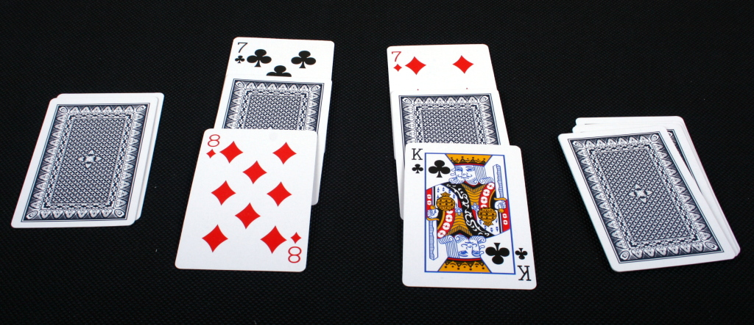
Game rules

Slide 5
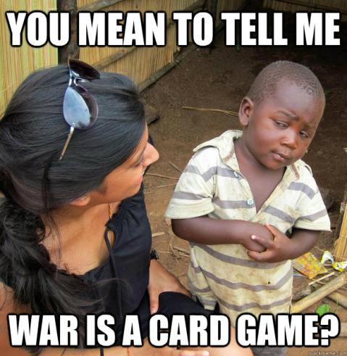
Thanks!

Slide 6
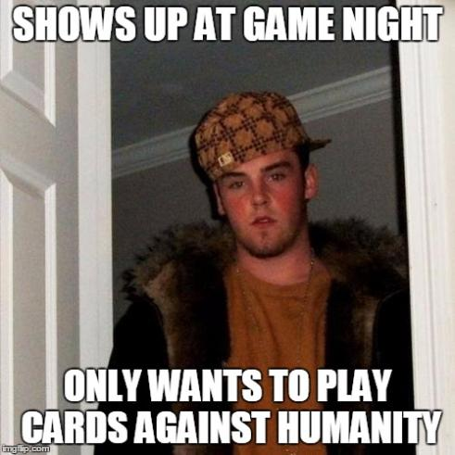
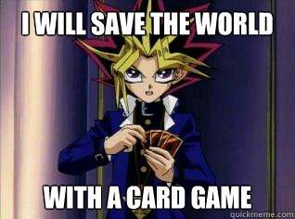
Memes

